Slide 1

Mc-Culloch Pitts Model- Implementation of AND Gate.
CASE STUDY-1
DEPARTMENT OF EEE
IV year -1semester
Academic year: 2020-2021
Presented By:
18985A0208 – A.SAI SAMPATH
18985A0232 – G.CHINNA
18985A0247 – L.RATNAKARA RAO
18985A0271 – Y.VASUDEVA
FACULTY:
Dr.Raja Gopal Peesapati
Associate professor
RAGHU ENGINEERING COLLEGE
(AUTONOMOUS)

Slide 2
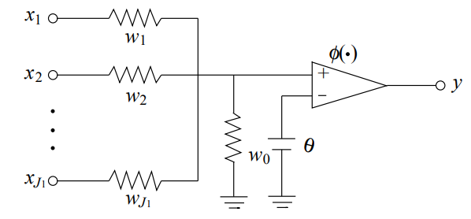
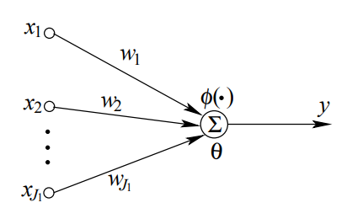
Mc-Culloch-Pitts Model.
A neuron is a basic processing unit in a neural network. It is a node that processes all fan-in from other nodes and generates an output according to a transfer function called the activation function.
The activation function represents a linear or nonlinear mapping from the input to the output and is denoted by φ. The variable synapses is modeled by weights. The McCulloch–Pitts neuron model , which employs the sigmoidal activation function, was inspired biologically.
Mathematical Model of Mc-Culloch-Pitts Model.
VLSI Model of Neuron

Slide 3
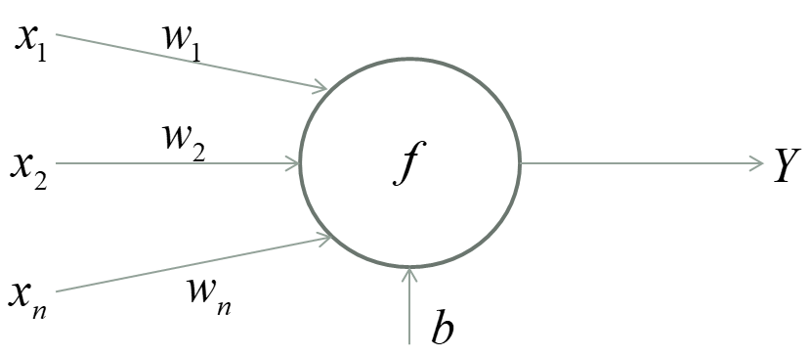
Contd.
Mc-Culloch Pitts Neuron Model.
By applying Kirchhoff's Current law the voltage of the neuron can be derived as below:

Slide 4
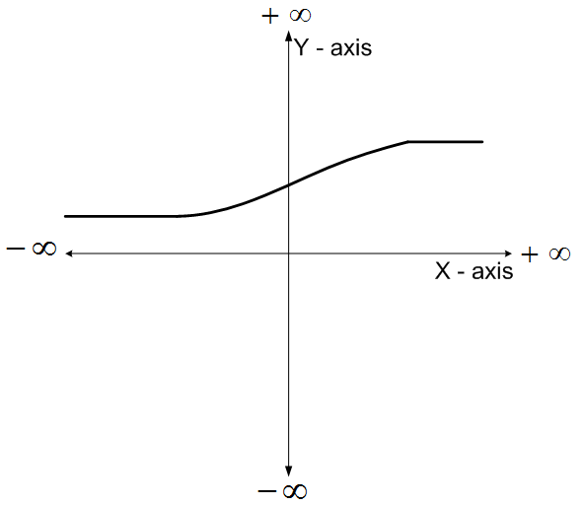
Sigmoid Function.
Here,
Positive parameter to control the slope of the function
When x = 0, the output of the function is 0.5
As x increases from 0 the output approaches 1 and as x decreases from 0 the output approaches 0.
If the value of T is set to a small value the slope of the function becomes steep and approaches the step function

Slide 5
Implementation of AND Gate.
When x is less than or equal to 0, f(x) is 0 and when x is larger than 1 then f(x) is 1.
X1 | X2 | W1 | W2 | Weighted input
0 | 0 | 1 | 1 | 0
1 | 0 | 1 | 1 | 1
0 | 1 | 1 | 1 | 1
1 | 1 | 1 | 1 | 2

Slide 6
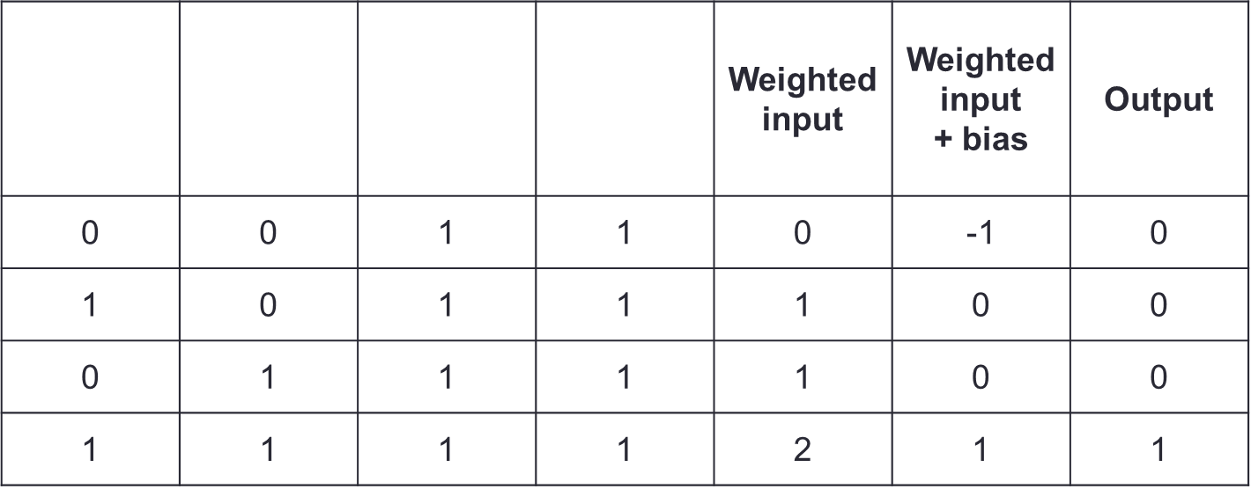
With Bias.
X1
X2
W1
W2

Slide 7
Conclusion.
The McCulloch–Pitts neuron model is known as the classical perceptron model, and it is used in most neural network models, including the MLP and the Hopfield network.
Many other neural networks are also based on the McCulloch–Pitts neuron
model, but use other activation functions. For example, the adaline and the SOM use linear activation functions, and the RBF network adopts a radial basis function (RBF).

Slide 8
Thank You.

